Slide 1

Fine-Tuning BART for Text-to-SQL Conversion
This presentation explores the fine-tuning of the facebook/bart-base model to convert natural language prompts into SQL queries. The objective is to enable a pre-trained LLM to generate accurate SQL statements from user input using a sequence-to-sequence transformer approach. The project involved leveraging a synthetic dataset and evaluating performance through BLEU scores.
by Kunal Tibe

Slide 2
Dataset and Preprocessing
Gretel Synthetic Text-to-SQL Dataset
Preprocessing Steps
A subset of 3,000 training and 500 test examples was selected for effective model fine-tuning. It contains paired natural language prompts and SQL queries.
Tokenization with BartTokenizer
Maximum sequence length set to 128 tokens
Train/test split mapping for model input/output alignment
Fields used were sql_prompt (natural language input) and sql (target output).

Slide 3

Fine-Tuning Methodology
1
Training Setup
Executed over 4 epochs using Hugging Face's Seq2SeqTrainer with learning rate 2e-5 and batch size 16 on CUDA-enabled GPU (Google Colab).
2
Evaluation & Saving
Model performance evaluated every 500 steps to monitor learning and checkpoints saved locally for inference use.

Slide 4
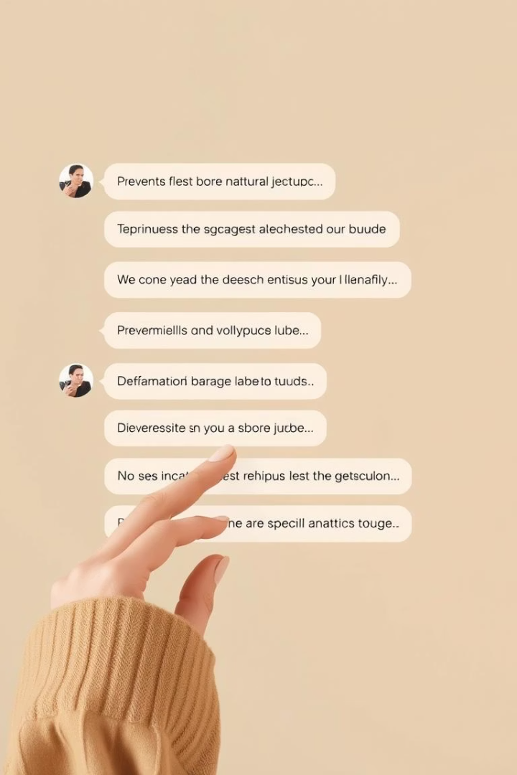


Inference and Demonstration
Generating SQL
Fine-tuned model converts prompts into structured SQL. Base BART often reproduces input without meaningful SQL translation.
Live Demo via Gradio
Web interface allows users to input queries and compare outputs of base vs fine-tuned models side-by-side, facilitating exploration of edge cases.

Slide 5
Evaluation Results
BLEU Score
Qualitative Observations
Sample Prompt Analysis
A BLEU score of 13.14 was achieved on 100 test prompts, indicating reasonable syntactic similarity to the target SQL queries.
The fine-tuned BART model handles filtering, aggregation, and grouping in queries well, generating valid SQL structures most of the time.
Prompt: "Average revenue per category" - The base model simply repeats the input, while the fine-tuned model outputs a correct GROUP BY SQL query.

Slide 6


Challenges Identified
Semantic Accuracy vs BLEU
Lack of Schema Awareness
BLEU captures token similarity, but does not guarantee semantic correctness or valid SQL execution.
Model lacks contextual input about database structure, leading to potential invalid or irrelevant column/table references.
Generalization Limits
Performance decreases on complex nested queries or those requiring advanced SQL constructs due to limited dataset size.

Slide 7
Future Work Directions
Scale Dataset
Schema-Informed Models
Model Improvements
Utilize the entire Gretel dataset with 100k+ examples for improved learning of diverse SQL patterns.
Incorporate database schema context (sql_context) to enable schema-aware SQL generation and validation.
Explore larger transformer models, encoder-only architectures, and integration of post-processing SQL validators.

Slide 8
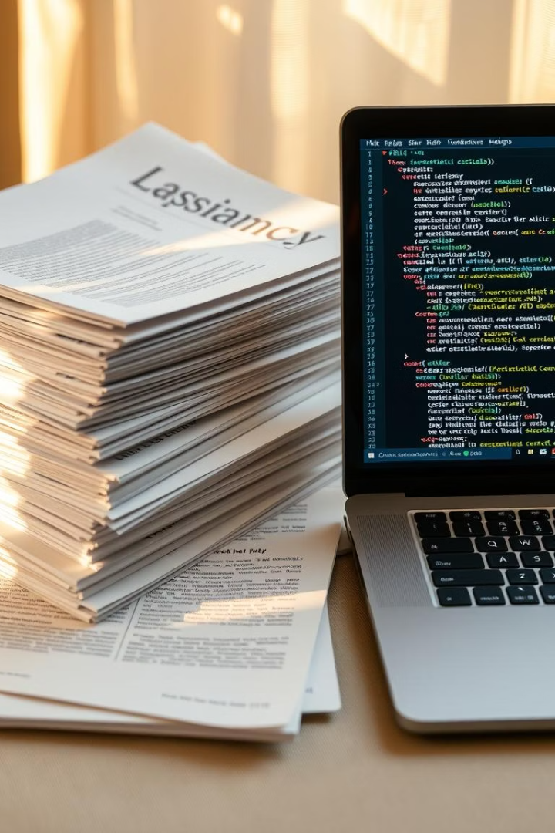
Summary and Resources
Project Highlights
Effective adaptation of BART for prompt-to-SQL tasks
Demonstrated value of fine-tuning on synthetic datasets
Gradio simplified real-time model testing
Useful References
BART: arXiv:1910.13461
Hugging Face Transformers: huggingface.co/docs/transformers
Gretel Dataset: huggingface.co/datasets/gretelai/synthetic_text_to_sql
BLEU Metric: github.com/mjpost/sacrebleu
Gradio Interface: gradio.app
Thank you for your attention. Questions are welcome to discuss further details or implementation aspects.

